Slide 1

PROJECT TITLE: "STUDENT GRADE CHECKER IN C"
Language:HTML,CSS,Javascript
Coding Interface:Visual Code Studio

Slide 2
PROJECT OVERVIEW
Jersey stories is a jersey and sportswear selling website which is easy for customers to use. Subsequently, a user-friendly interface guides customers to place a order and get our updates by signing up to the website.People can buy accessories also from here at a low price by staying at home.As customers can order from home so the main goal of this project is to take order and deliver it as soon as possible. We added some frequently asked questions for the customers to get their common questions answer on their own and added the policies of return and delivery system not to get tensed about time and product.

Slide 3



OBJECTIVES
USER-FRIENDLY INTERFACE
FIT FOR USE
UPDATED PRODUCTS
ALL IN ONE PLACE

Slide 4
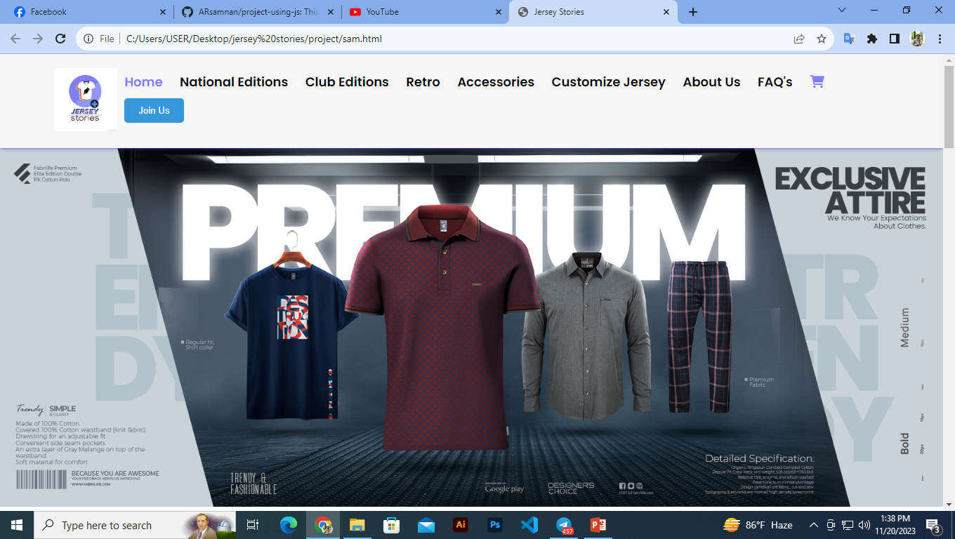
USER INTERFACE
Lorna Alvarado

Slide 5
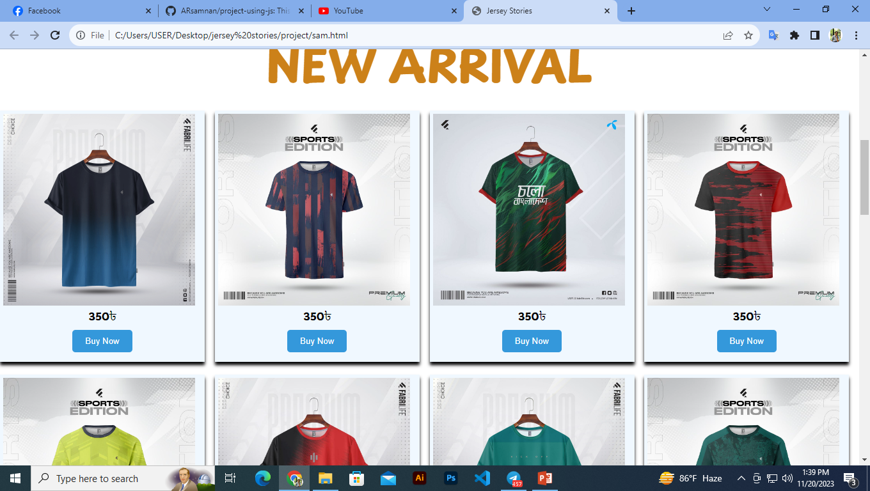
USER INTERFACE
Lorna Alvarado

Slide 6
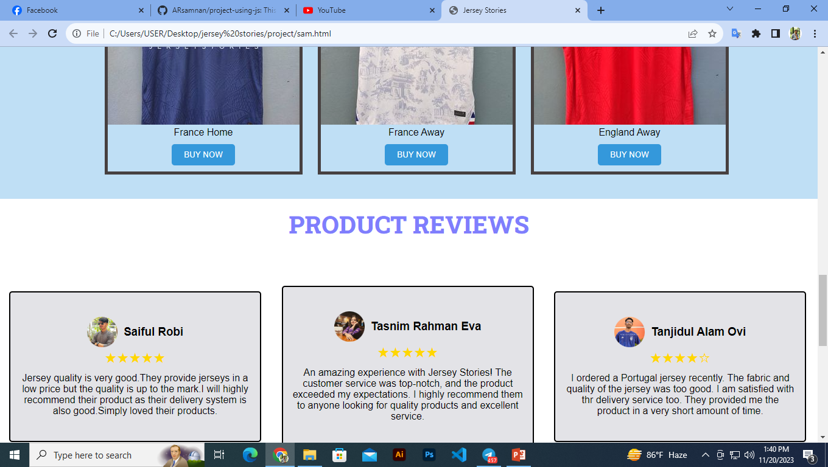
USER INTERFACE
Lorna Alvarado

Slide 7
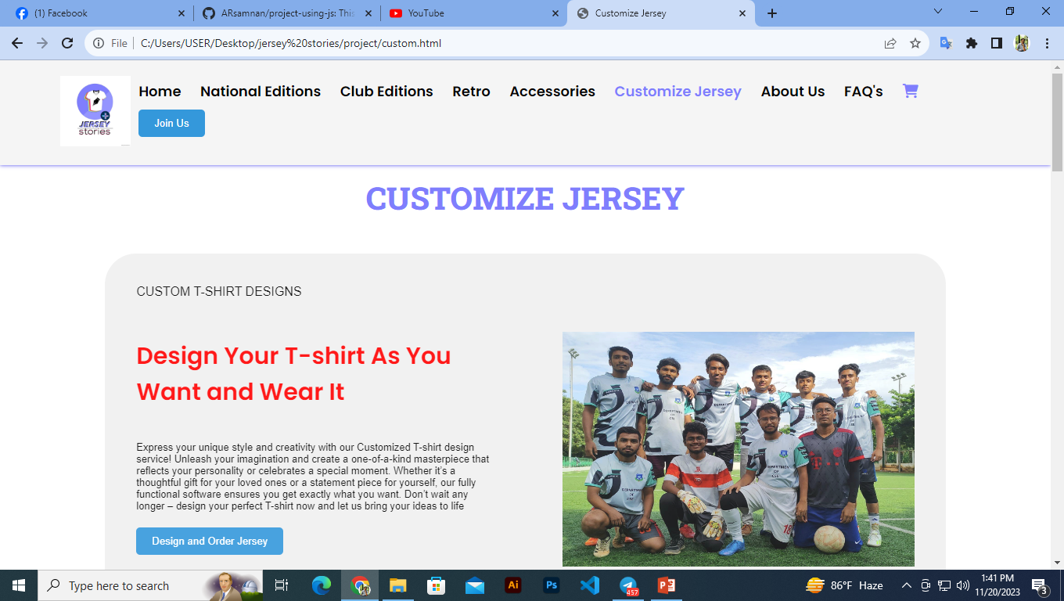
USER INTERFACE
Lorna Alvarado

Slide 8
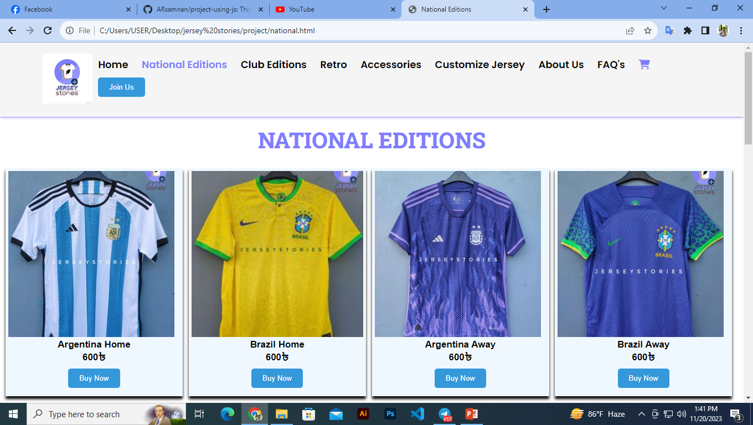
USER INTERFACE
Lorna Alvarado

Slide 9
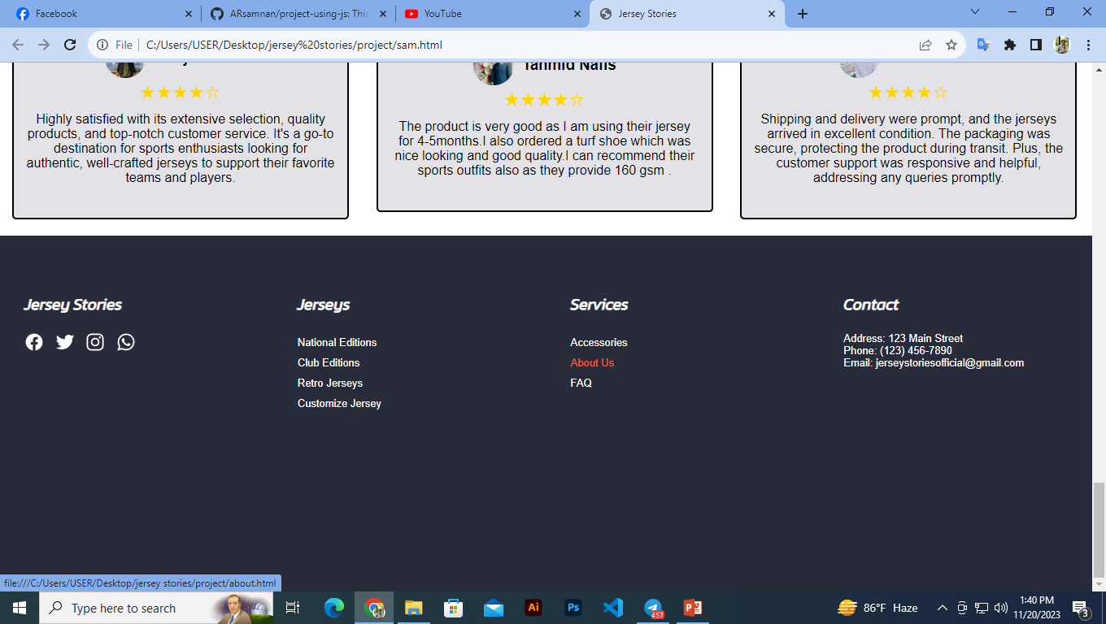
USER INTERFACE
Lorna Alvarado

Slide 10
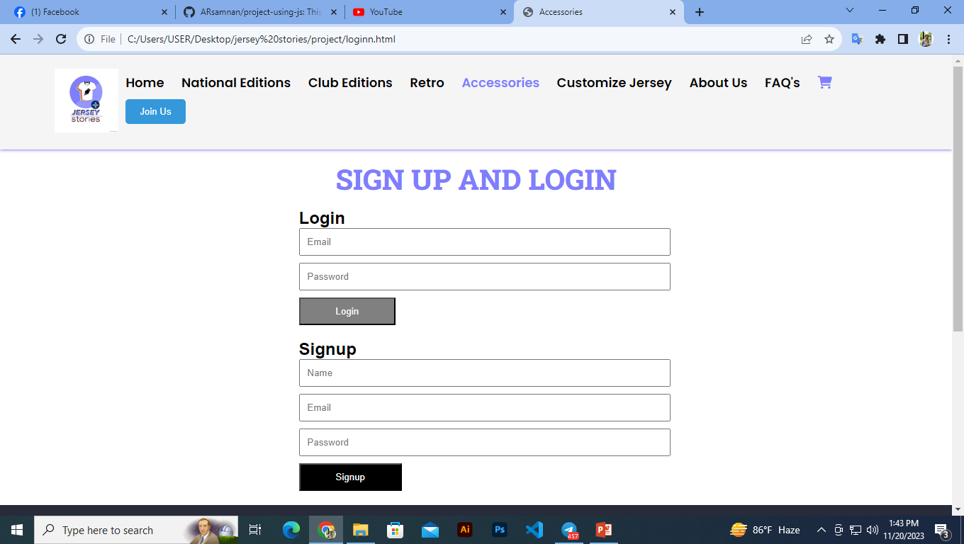
USER INTERFACE
Lorna Alvarado

Slide 11
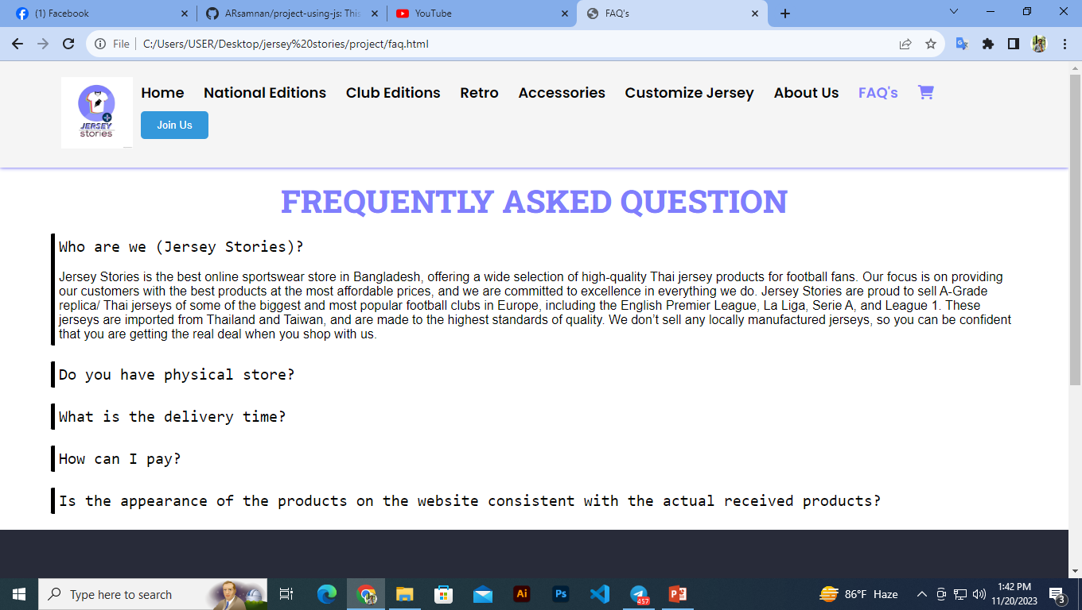
USER INTERFACE
Lorna Alvarado

Slide 12



ACCURACY
DELIVERY IN TIME
COOPERATIVE USE
QUALITY

